Slide 1
What’s New in Azure Functions
Katy Shimizu – Software Engineer II

Slide 2
Agenda
Functions
Key Concepts
Best Practices
V2 Runtime
Durable Functions
Notes:
Jeff will have gone over Functions yesterday and showed you a quick demo; I want to recap the basics, talk about the new V2 runtime, and then spend the bulk of this hour doing a deep dive into one of our newest offerings, Durable Functions.

Slide 3



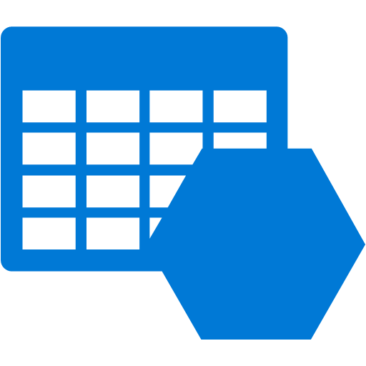


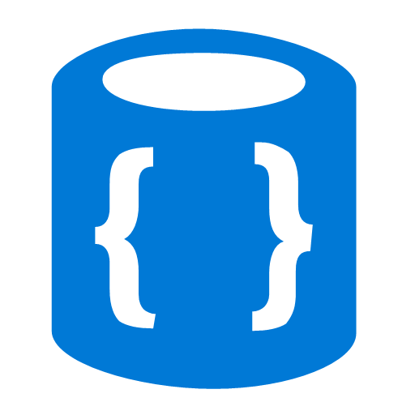


Azure Functions
Events
Code
Outputs
React to timers, HTTP, or events from your favorite Azure services, with more on the way
Author functions in C#, F#, Node.JS, Java, and more
Send results to an ever-growing collection of services
Notes:
Basic concept of functions – event-driven serverless code in whatever language you like.

Slide 4
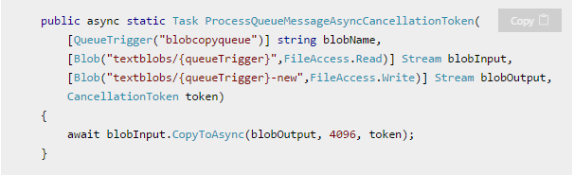
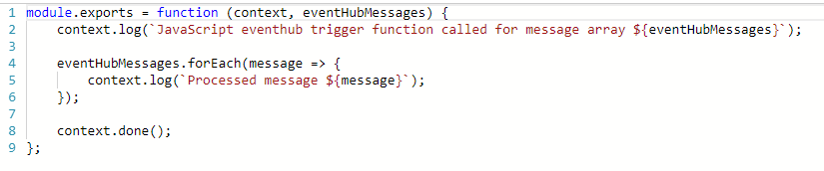
What is the “Functions” programming model?
Function as the unit of work
Functions are executed; they start and finish
Functions have triggers
Functions can have inputs and outputs (bindings)
Notes:
First, a simple event hub JS function (just trigger)
Then, a good example of a C# function with a trigger and input/output bindings

Slide 5
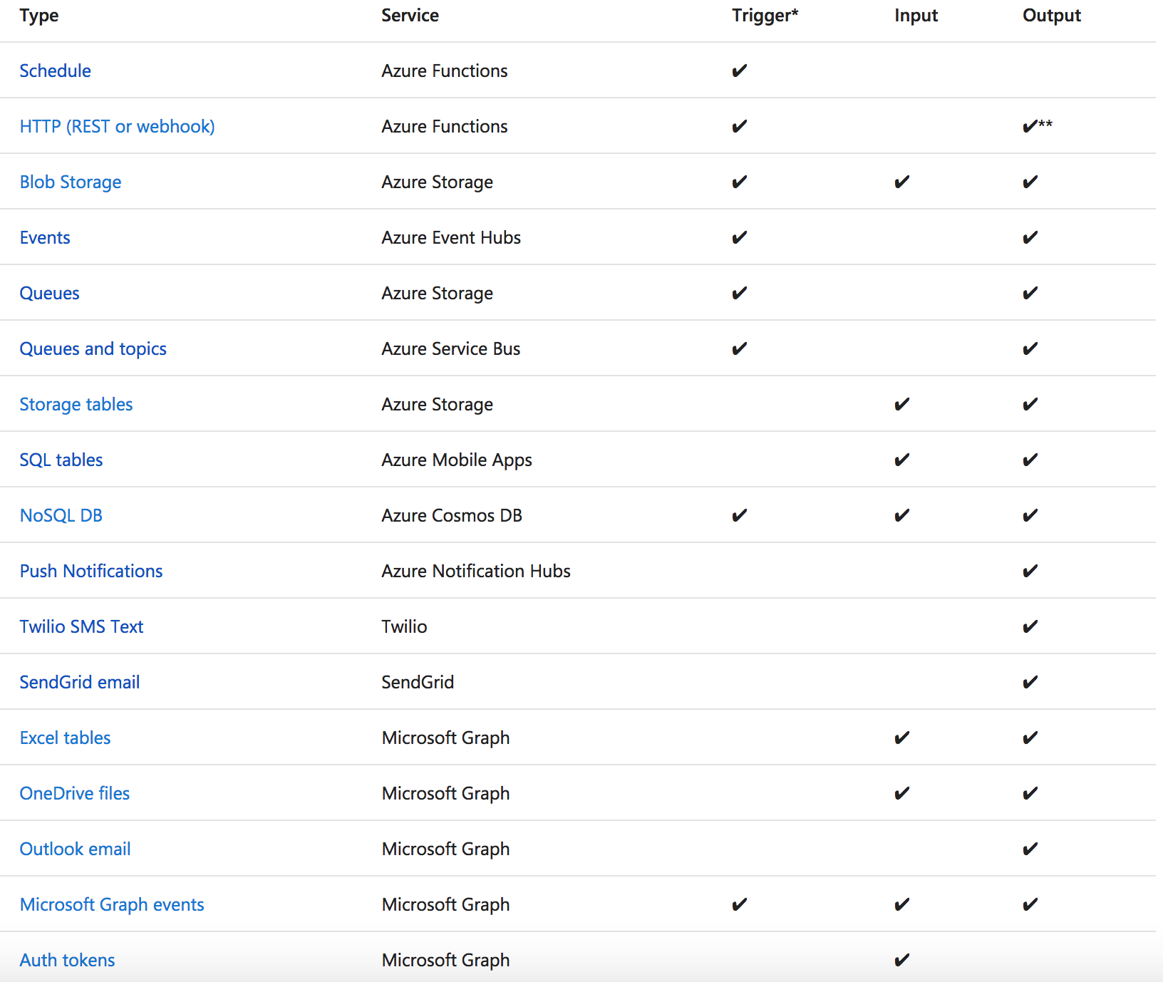
Functions triggers and bindings
Notes:
As I mentioned earlier, triggers and bindings are the things that facilitate easy communication with other services. This chart shows us the triggers and bindings currently supported. As we can see, there are a number of Azure services supported here…. for Storage, Database, Messaging, Notifications and so on. In addition to those, Functions also support generic Http triggers, which means you can easily write a piece of code that can be used to respond to REST requests or requests from any service that supports webhooks. This also provides a really fast and easy mechanism for building extensions to SaaS applications. We are fully committed to making this list grow and making more check-marks appear in that table.

Slide 6
Demo
Functions in VS Tooling

Slide 7
Best Practices
Use App Insights EVERYTIME
Do as little work synchronously as possible
Trigger in batches
Don’t forget to catch exceptions
Global static variables for things like HttpClient or “cached” values
Don’t forget about the host.json file
VSTS Release Management pipeline for DevOps
Can also do GitHub / Source Control deploy for “simple” CI/CD

Slide 8
Runtimes and Languages – V1 Runtime (GA)
Host runs .NET Framework 4.6.1
C#/F# Functions run in same host process (.NET Framework 4.6.1)
Node.js also runs in same host process (using Edge – LOCKED at Node 6.5.0)
A few other “experimental” languages that also run in process. Not a scalable model.
Notes:
When you create Functions today, you default to the V1 runtime. It’s great for C# and F# functions, but a big limitation is that due to running Node.JS in the host process, the version of Node you can use is locked at 6.5.0.

Slide 9
Runtimes and Languages – V2 Runtime (Preview)
Host runs .NET Core 2.0
C#/F# Functions run in same host process (.NET Core 2.0)
New extensibility model for languages where “language workers” run out-of-process.
Node.js – defaults to 8.4.0 but now can opt in to newer versions
Java
Python (early in progress)
Other languages in discussion / investigation
New extensibility model for bindings
Lighter core runtime
Version control
Today requires you manually “func extensions install” to use bindings / triggers
Notes:
Our V2 runtime has a number of improvements:
Our host runs .NET Core 2.0
While C# and F# still run in the same host process, we have a new extensibility model for other languages.
Language workers run out of process.
This means that if you want to go out and write a language worker for Ruby or Go, you can do so. We have information available in the azure-webjobs-sdk-script GitHub repo’s wiki.
We have an extensibility model for bindings, which we’ve made more declarative as well, and we’ve centralized some of the binding logic that used to have to be implemented per-extension.
V2 is still in preview, but we anticipate a GA release later this year. You can try it out by setting your FUNCTIONS_EXTENSION_VERSION app setting to beta in the portal, or installing the latest Azure Functions and Web Jobs Tools in Visual Studio.
There are also cool new features being developed for V2, including Durable Functions, which I’ll focus on for the rest of this talk.

Slide 10

Complex Workflows
F1
F2
F3
F4
F1
F3
F2
Notes:
You might deal with a complex workflow in Functions. For example, you might have a multi-step process. Instead of writing it as one large function, you can break it up into a series of smaller functions, each consuming the previous one’s input. Another scenario is a batched file whose contents needs to be broken up and processed individually, then re-aggregated.
While these workflows are possible in Functions, coordinating multiple functions and maintaining state can quickly become complex.
Enter Durable Functions.

Slide 11
Durable Functions
Azure Functions extension
Enables long-running, stateful serverless operations
Write complex function orchestrations in a single C# function
Manages state, checkpoints and restarts
Built on the open-source Durable Task Framework
Notes:
Durable Functions is an Azure Functions extension that enables long-running, stateful serverless operations. With Durable Functions, you can coordinate complex functions workflows in a single C# function.

Slide 12
Key Concepts
Activity function
Orchestrator function
Bindings
Event sourcing

Slide 13
Activity Function
public static string SayHello(string name)
{
return $"Hello {name}!";
}
Notes:
Activity Functions are functions as you’re used to them. There are no restrictions on what they can do (apart from those on all functions.) In a Durable Function orchestration, the bulk of the work takes place here.

Slide 14
Orchestrator Function
// calls functions in sequence
public static async Task<List<string>> Run(DurableOrchestrationContext context)
{
var outputs = new List<string>();
outputs.Add(await context.CallActivityAsync<string>("SayHello", “Seattle"));
outputs.Add(await context.CallActivityAsync<string>("SayHello", “Amsterdam"));
// returns ["Hello Seattle!", "Hello Amsterdam!"]
return outputs;
}
Notes:
Orchestrator Functions are special to the Durable Functions extension. An orchestration function coordinates the calling of one or more activity functions. It’s where you define your workflow.
An orchestrator function can call other functions synchronously or asynchronously. Whenever an await instruction is encountered, the orchestrator function will automatically checkpoint its progress. This way, if the process or VM your function is running on recycles or reboots, local state isn’t lost.
The example onscreen is simple for the sake of space, but as we’ll see in later examples, orchestrator functions can define complex workflows including:
Flow control and branching logic
Infinite loops
Error handling

Slide 15
Bindings
Trigger Bindings
Orchestration Trigger Binding
Triggers orchestrator functions
Polls control-queue
Partition-aware
Handles return values
Activity Trigger Binding
Triggers activity functions
Polls work-item queue
Stateless
Handles return values
Non-Trigger Bindings
Orchestrator Client
Output binding
Start new orchestrator instances
Terminate instances
Send event notifications
Fetch instance status*
Notes:
Durable Functions introduces some new bindings to be aware of:
Orchestration Trigger binding – for orchestration functions.
Activity Trigger bindings – for activity functions you intend to call from orchestrator functions; allows function to hook into the framework.
Orchestrator Client binding – for starting new orchestrator instances. Currently, orchestrators are kicked off by making a request to an HTTP function. We have plans to take care of this for you.
* Fetching instance status feels odd for an output binding. We may need a separate input binding for this.

Slide 16
Event Sourcing
Local state as append-only execution history of actions
Orchestrator function schedules async work, shuts down
Orchestrator restarts and rebuilds its local state
Improved performance and scalability
Eventual consistency
Full audit trails and history
Notes:
Orchestrator functions maintain their state using a cloud design pattern called Event Sourcing. Instead of storing a single state, they store an execution history, or an append-only record of actions taken by the orchestration.
Orchestrator functions add to the execution history when they encounter an await statement, schedule the requested async work, and shut down. (Meaning that while you get billed for the execution time of the scheduled work, you don’t get billed for the orchestrator function waiting for the work to complete.) Once there’s more work to do, the orchestrator function wakes up and rebuilds its local state from its execution history.
This pattern has a lot of advantages, including improved performance and scalability, eventual consistency for transactional data, and full audit trails and history.

Slide 17
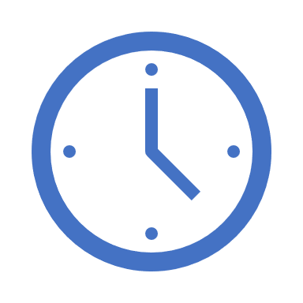

var outputs = new List<string>();
outputs.Add(await context.CallActivityAsync<string>("SayHello", “Amsterdam"));
return outputs;
Orchestrator Function
Orchestrator Function
Activity Function
Orchestrator Started
Activity Function
Execution Started
Task Scheduled, SayHello, “Amsterdam”
Orchestrator Completed
[“Hello Amsterdam!”]
“Hello Amsterdam!”
“Hello Amsterdam!”
Task Completed, “Hello Amsterdam!”
?
Orchestrator Started
Execution Completed, ["Hello Amsterdam!"]
Orchestrator Completed
Execution History
Notes:
Grasping how orchestrators use execution history to replay and rebuild their local state is key to understanding how Durable Functions works, so let’s walk through the execution of a simple orchestrator function.
The light blue box at the top of the slide is the orchestrator’s code.
“SayHello” our activity function, which returns “Hello” and whatever input you give it.
Our execution history is currently empty. As we start to record events, they’ll show up here. (Indicate area.)
1. A request is made to the orchestrator function.
2. The orchestrator starts and begins executing until it’s asked to await some async work. In this case, we want to call an activity function.
3. The orchestrator checks the execution history for a record of the activity function.
4. There’s no record of the activity function being called or completed, so the orchestrator schedules that work.
5. While the orchestrator waits on work to complete, it shuts down.
5. The scheduled activity function runs.
6. A record of this is added to the execution history. In this case we produced output, so that’s stored.
7. Now the orchestrator has more work to do. It restarts and executes its code **from the beginning** to build up its local state.
8. As before, the orchestrator executes until it reaches an await.
9. The orchestrator checks the execution history. This time there’s a record of the async work being done.
10. The activity function’s stored output is passed back to the orchestrator. In this case, the value is added to a list of strings.
11. The orchestrator continues executing. In a more complex orchestrator with multiple await calls, the checkpoint, schedule and replay steps would repeat for each one. This orchestrator runs to completion and returns its output.
12. And we’re done!
- How does the framework know to wake up

Slide 18
Pattern #1: Function Chaining
F1
F2
F3
F4
// calls functions in sequence
public static async Task<object> Run(DurableOrchestrationContext ctx)
{
try
{
var x = await ctx.CallFunctionAsync("F1");
var y = await ctx.CallFunctionAsync("F2", x);
var z = await ctx.CallFunctionAsync("F3", y);
return await ctx.CallFunctionAsync("F4", z);
}
catch (Exception)
{
// global error handling/compensation goes here
}
}
Notes:
With the basics down, I’m going to cover some patterns that are easy to implement in Durable Functions.
The first is Function Chaining, where the output of one function becomes input for the next. It’s possible to do this with regular Functions alone – you could, for example, store a function’s output in a queue to be picked up by the next function in the sequence. However:
Queues create additional overhead.
There’s no visualization showing the relationship between the functions. (You could maintain a separate document, but that’s more maintenance overhead.)
Additional complexity arises when you consider error handling.
Durable Functions orchestrators are capable of the error-handling structures you’re used to like try-catch blocks and self-document the relationship between activity functions. Here’s what the one for this scenario would look like – note that since the activity functions’ return values are stored as local state, they’re maintained for you as part of the execution history.

Slide 19
Pattern #2: Fan-Out/Fan-In
F1
F3
F2
Notes:
Fan-out/fan-in involves execution multiple functions in parallel and waiting for them all to finish. Some aggregation work might be done on the results.
The fan-out part can be done with regular functions by sending multiple messages to a queue, but fan-in is significantly harder; you would need to keep track of when those queue-triggered functions finish and their outputs. The problems of visualization, overhead and error-handling are also still with us.

Slide 20
public static async Task Run(DurableOrchestrationContext ctx)
{
var parallelTasks = new List<Task<int>>();
// get a list of N work items to process in parallel
object[] workBatch = await ctx.CallActivityAsync<object[]>("F1");
for (int i = 0; i < workBatch.Length; i++)
{
Task<int> task = ctx.CallActivityAsync<int>("F2", workBatch[i]);
parallelTasks.Add(task);
}
await Task.WhenAll(parallelTasks);
// aggregate all N outputs and send result to F3
int sum = parallelTasks.Sum(t => t.Result);
await ctx.CallActivityAsync("F3", sum);
}
Notes:
As before, a Durable Functions orchestrator spells out the relationship between functions, handles storing state, and facilitates error-handling. Fan-in is handled by the highlighted line of code using the familiar WhenAll method of the .NET’s Task library.

Slide 21
Pattern #3: HTTP Async Response
Start
DoWork
GetStatus
Notes:
Our next pattern deals with communicating the state of long-running operations to external clients. If you have a long-running action triggered by an HTTP call, a common way to handle it is to redirect the client to a status endpoint they can poll to learn when the operation completes. This strategy requires you to store and manage execution state, and keep it in sync with your trigger state. Often this is boilerplate code that isn’t related to the business problem.

Slide 22
> curl -X POST https://myfunc.azurewebsites.net/orchestrators/DoWork -H "Content-Length: 0" -i
HTTP/1.1 202 Accepted Location: https://myfunc.azurewebsites.net/orchestrators/b79baf67f717453ca9e86c5da21e03ec Server: Microsoft-IIS/8.0
> curl https://myfunc.azurewebsites.net/orchestrators/b79baf67f717453ca9e86c5da21e03ec -i
HTTP/1.1 202 Accepted Content-Length: 173 Content-Type: application/json Location: https://myfunc.azurewebsites.net/orchestrators/b79baf67f717453ca9e86c5da21e03ec Server: Microsoft-IIS/8.0
{"runtimeStatus":"Running","createdTime":"2017-03-16T21:20:36Z","lastUpdatedTime":"2017-03-16T21:20:47Z"}
> curl https://myfunc.azurewebsites.net/orchestrators/b79baf67f717453ca9e86c5da21e03ec -i
HTTP/1.1 200 OK Content-Length: 175 Content-Type: application/json Server: Microsoft-IIS/8.0
{"runtimeStatus":"Completed","createdTime":"2017-03-16T21:20:36Z","lastUpdatedTime":"2017-03-16T21:20:57Z"}
Notes:
Durable Function provides built-in APIs for this purpose. When you call an orchestrator, the extension exposes webhook HTTP APIs to query the orchestrator function’s status. If you’d like to implement this pattern yourself using your own function triggers and the Orchestration Client binding, you can, but we provide an out-of-the-box option that works for many common situations.

Slide 23
Demo
HTTP Async Response

Slide 24
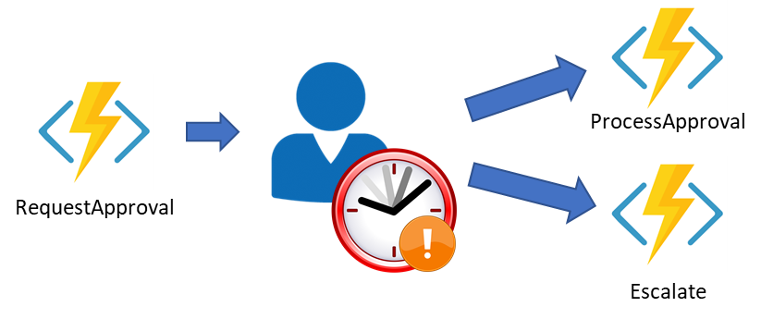
Pattern #4: Human Interaction w/Timeout
Notes:
Some workflows require a human interaction step which needs to account for a response that is delayed or never comes. For example, an approval process for an expense report might require an approval from a manager – but if the manager doesn’t respond within 72 hours, you want to escalate the approval request.
In this case, you have two competing events – the approval request notification and the timeout – that need to be coordinated. Depending on which event is received first, different actions need to be taken. There’s currently no way in regular functions to manage this sort of pattern, but it becomes simple with Durable Functions.

Slide 25
public static async Task Run(DurableOrchestrationContext ctx)
{
await ctx.CallActivityAsync<object[]>("RequestApproval");
using (var timeoutCts = new CancellationTokenSource())
{
DateTime dueTime = ctx.CurrentUtcDateTime.AddHours(72);
Task durableTimeout = ctx.CreateTimer(dueTime, 0, cts.Token);
Task<bool> approvalEvent = ctx.WaitForExternalEvent<bool>("ApprovalEvent");
if (approvalEvent == await Task.WhenAny(approvalEvent, durableTimeout))
{
timeoutCts.Cancel();
await ctx.CallActivityAsync("HandleApproval", approvalEvent.Result);
}
else
{
await ctx.CallActivityAsync("Escalate");
}
}
}
Notes:
The DurableOrchestrationContext object provides methods to create timers which can be used to re-activate the orchestrator function at a specified time. In the example above, we take the current time at which the orchestrator first runs and add 72 hours to it. Then, using Task.WhenAny, we wait on an external approval event or the timeout, and take action based on which event completed first.

Slide 26
Important Orchestrator Limitations
Orchestrator code is replayed on every rehydration to restore all local state (local variables, etc.).
Activity function calls are never replayed – the outputs are remembered.
Rebuilding state using history is known as Event Sourcing
Orchestrator code must be deterministic.
Rule #1: Never write logic that depends on random numbers, DateTime.Now, Guid.NewGuid(), etc.
Rule #2: Never do I/O directly in the orchestrator function.
Rule #3: Do not write infinite loops
Rule #4: Use the built-in workarounds for rules #1, #2, and #3
Notes:
We’ve covered the core concepts of Durable Functions and some common workflow patterns it can handle. Because orchestrator code **replays** to rebuild local state, it should run the same on each playthrough. In other words, orchestrator code must be deterministic. (There are no such restrictions on activity functions’ code.)
Fortunately, the most common non-deterministic scenarios can be avoided by keeping some simple rules in mind when writing orchestrator code.
(read rules)
Workarounds for these scenarios have been implemented, and our documentation contains guidelines to avoid non-deterministic code in orchestrator functions in more detail.

Slide 27
Language Support
C# is the only officially supported language at this time.
JavaScript support is in-progress.
Notes:
Durable Functions is currently only officially supported in C#, and we’re actively working on adding support for other languages. First up is Node.JS, and if you’re interested, you can see how this is going on GitHub, because..

Slide 28
More Durable Functions
GitHub: https://github.com/Azure/azure-functions-durable-extension
Docs: https://docs.microsoft.com/en-us/azure/azure-functions/durable-functions-overview
Twitter:
@AzureFunctions
@kashimizMSFT
Notes:
..we’re open-source! Our entire codebase is available on GitHub. We really want to hear from the community what’s working, what isn’t, and where Durable Functions should go, so I invite you to check us out, file issues, and if you’re so inclined, contribute a pull request. This is one of the best ways to get in touch with the team, and we’d really love to hear from you.
You can also check out our documentation on Microsoft Docs; there are comments sections there, but we don’t monitor them as closely as our GitHub repo, so please post any documentation comments as issues.
And finally you can follow us (and me) on Twitter, which is another good way to engage with the team if you have questions, comments, or just want to tell us what cool stuff you’re building with Functions and Durable Functions! We love hearing how people are using our tools out in the wild, and helping people succeed in doing so.
I’ll open the floor up for questions now. Thank you!

Slide 29
Challenge Architecture
CheckState
?
Monitor
SendAlert
Notes:
Monitor Pattern

Slide 30
Why take a dependency on DTFx?
It’s a proven platform for building code-first orchestrations. Several Microsoft internal teams use it for production workloads today.
Time-to-market is important since serverless is an emerging industry trend.
It’s open source, which gives us greater flexibility.
Note that we’ve abstracted away the DTFx dependency, which allows us to swap it out if absolutely necessary.

Slide 31
Difference between this and Logic Apps?
Code vs. Designer
Durable Functions caters to developers who prefer code over designers or JSON schemas.
Logic Apps caters to those who want to write less code.
Orchestration vs. Integration
Orchestrator functions can express very complex logic using simple code constructs but lacks integration tools.
Logic Apps has a massive collection of actions and connectors, great for integration scenarios, but is naturally more limited in its expressiveness.
Portable Runtime
Local development/debugging
Enables orchestration in IoT Edge, windows server, containers, etc.
Management Experience
Logic Apps has a rich Azure portal-based management experience
Durable Functions requires you to build your own using the various web-hooks it supports.
Each platform has a slightly different monitoring solution.
Notes:
The specifics of the versioning story are still being worked out.

Slide 32
Functions and Logic Apps (Continued)
Functions and Logic Apps work great together and that integration will only get better.
You can orchestrate Functions using Logic Apps today.

Slide 33
Difference Between this and Service Fabric
Both are similar in that they allow for scalable stateless compute. There is a radical difference in the developer experience.
Key differences:
Serverless: Durable Functions is completely “serverless”. There are no VMs or clusters to manage or configure.
Local state: Service Fabric stores state locally on the VM disk. Durable functions externalizes all state.
Programming model: Service Fabric has reliable collections for managing state. Durable Functions has no such concept – the statefulness is implicit.
Partitioning: Service Fabric customers must manage partition counts and partition strategies. Durable Functions customers only configure partition counts.
VM Scale-out: Service Fabric relies on scale characteristics of VM scale sets + has a 5 VM minimum/500 maximum. Durable Functions relies on scale characteristic of Azure Functions, no minimum. Maximum VM count depends on the region (generally in the hundreds).
Service Fabric can theoretically provide much greater throughput, but will be much more expensive both in terms of billing and management, especially at small scale.

Slide 34
How is this “transactional”?
Transactions have a lot of important properties that are consistent with most workflow/orchestration engines:
Serializability: Sequential function calls are guaranteed to run in a deterministic order with deterministic inputs/outputs.
Durability: State changes (including local variable state) survive failures.
Consistency: Specifically, this is local consistency. Checkpointed states are strictly consistent and can always be recovered.
Compensation: try/catch allows rolling back changes using custom logic if there is an application failure.

Slide 35
Functions “Behind the scenes”
App Services Infrastructure
Functions Instance
Azure Functions Runtime
HTTP Request
Azure Functions (App Services) HTTP Front-end
Functions Instance
HTTP Response
Azure Functions Runtime
Scale Controller
Functions Instance
Azure Functions Runtime

Slide 36
Scalability Considerations
The “Scale Controller” determines how many instances are actively doing work
For Event Hub, Queue, Service Bus the scale controller can assess message backlog length and burndown rate to scale
For HTTP functions today looks at request queue for each instance
The “host.json” config file allows you to set instance limits for concurrency at an instance level
Other knobs are to turn of file-system logging, and not include a dashboard storage account
Process items in a batch-per-execution for high scale scenarios (e.g. Event Hub)

Slide 37
Cold Start
The time it takes to ready an instance when no instance yet exists
Varies greatly on a number of factors like language and # of files
Today for C# in v1 is generally around 3-4 seconds today, 1-2 seconds in on-deck release
Few angles of attack
Pre-warmed “workers”
Zipped artifacts without extract (Zip Deploy)
Keep alive (keep warm longer)
Users can help mitigate by:
Using Zip Deploy if possible (paired with something like funcpack for Node)
Use C# Class Libraries over .csx for large functions
If push comes to shove, a “pinger” can keep warm

Slide 38
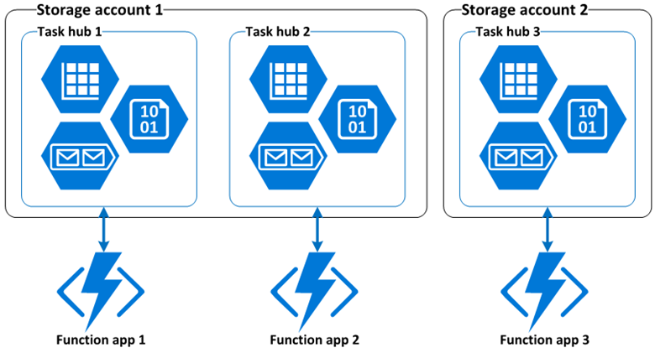
Task Hubs
Notes:
I told some people yesterday that orchestrator functions can only call activity functions in the same function app. This is true, but the reality is slightly more nuanced, and introduces the concept of a task hub.
A task hub in Durable Functions is a logical container for Azure Storage resources that are used for orchestrations.
Orchestrator and activity functions can only interact with each other when they belong to the same task hub.
Each function app has a separate task hub.
If multiple function apps share a storage account, the storage account contains multiple task hubs.
The following diagram illustrates one task hub per function app in shared and dedicated storage accounts.
A task hub consists of the following storage resources:
One or more control queues.
One work-item queue.
One history table.
One storage container containing one or more lease blobs.
Task hubs can be named in your host.json file.
The name is what differentiates one task hub from another when there are multiple task hubs in a shared storage account.
If you have multiple function apps sharing a shared storage account, you have to configure different names for each task hub in the host.json files.

Slide 39

Storage Backend & Scale
Worker
Worker
Control Queue(s)
Worker
Work Item Queue
Triggers orchestrator
function execution
Triggers activity function execution
Worker
Worker
Stateful/Partitioned
History Table
Stateless
Notes:
History Table: Contains history events for all orchestration instances. Partition key derived from instance ID of orchestration – we use an internal hash function of the instance ID, which are random GUIDs by default, for optimal distribution across partitions. (Take this into account if you’re giving custom instance IDs to your orchestrators.)
Orchestrator and Activity Functions are both triggered by internal queues in the function app’s default storage account.
Work-Item Queue: Used to trigger stateless activity functions. One work-item queue per task hub. When a DF app scales to multiple VMs, the VMs compete to acquire work from the queue.
Control Queue: Used to trigger the stateful orchestrator functions. Because orchestrator functions are stateful singletons, it’s not possible to use a competing consumer model to distribute load across VMs. Instead, orchestrator messages are load-balanced across multiple control queues.
So what does this mean?
If you’re running on a consumption plan, auto-scale is supported via the scale controller like a regular Functions app.
Activity functions scale out automatically.
Orchestrator functions are partitioned. The number of control queues can be configured in your host.json as of yesterday.
Each VM takes a lock on a control queue. This ensures an orchestration instance only runs on one VM at a time.
Orchestrator function handling scale-out is capped at your number of control queues. The intent is that orchestrator functions are lightweight and don’t require a lot of compute power.
Activity functions scale limitlessly.
Threads: Orchestrator functions are executed on a single thread to ensure deterministic behavior. Therefore, be mindful and avoid blocking operations like I/O (which you shouldn’t be using in an orchestrator anyways), spinning, or so on.
Move multi-threaded work into activity functions.
Re: threads in activity functions: . Yes, you can instantiate threads. They're all still tracked as normal CPU cycles since they all originated from the same process.
There are some numerical sandbox limits, detailed in the project kudu wiki.
We recently added a configurable Host Health Monitor that will watch when you get close to the limits:

